Slide 1


Taylor Mason
December 1st, 2022

Slide 2

Table of Contents
Table of Contents
Executive Summary
Introduction
Methodology
Results
Conclusion

Slide 3
Executive Summary
Summary of methodologies
Data Collection with API’s
Data Collection with Web Scraping
Data Cleaning/Wrangling
Exploratory Data Analysis with SQL
Exploratory Data Analysis with Data Visualization
Interactive Map Analytics with Folium
Machine Learning Prediction with SciKit-Learn
Summary of all results
Exploratory Data Analysis Results
Screenshots from Interactive Dashboards & Maps
Predictive Analytics Results

Slide 4
Introduction
Project background and context
SpaceX advertises Falcon 9 rocket launches on its website, with a cost of 62 million dollars; other providers cost upward of 165 million dollars each, much of the savings is because SpaceX can reuse the first stage. Therefore, if we can determine if the first stage will land, we can determine the cost of a launch. This information can be used if an alternate company wants to bid against SpaceX for a rocket launch. The goal of the project is to create a machine learning pipeline to predict if the first stage will land successfully.
Problems you want to find answers
What factors impact the rocket landing success rates?
Are there interactions between various features that impact the rate of a successful landing?
What are the optimal conditions for a successful landing program?

Slide 5

Section 1

Slide 6
Methodology
Executive Summary
Data collection methodology:
Data was collected with the SpaceX API as well as webscraping from Wikipedia
Perform data wrangling
Data was processed and cleaned with Pandas to prepare data for analysis
Perform exploratory data analysis (EDA) using visualization and SQL
Perform interactive visual analytics using Folium and Plotly Dash
Perform predictive analysis using classification models
How to build, tune, evaluate classification models

Slide 7
Data Collection
Data collection methods/process
First, SpaceX Launch data was pulled from the SpaceX public API using the Requests library and the Get function
Next, the response from the first step was decoded using the .json() function
After that, the .json_normalize() function was used to turn the json file into a Pandas dataframe
Once the data was in a dataframe it was reviewed and cleaned for further analysis
In addition to using the Requests library, the Beautiful Soup Library was also used to extract data from SpaceX Launch Data from Wikipedia

Slide 8
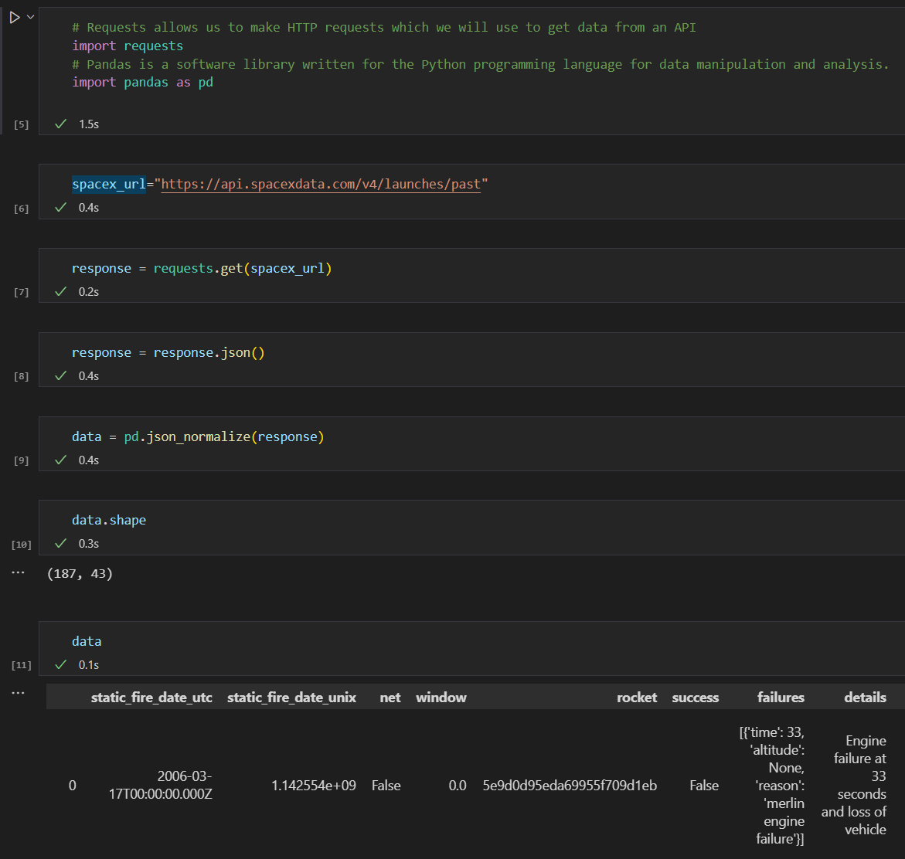
Data Collection – SpaceX API
The general steps included using the Requests library and the Get function to extract the SpaceX Launch data.
Once we have the data we use the .json() and .json_normalize functions to transform the data into a dataframe for further analysis.
GitHub URL

Slide 9
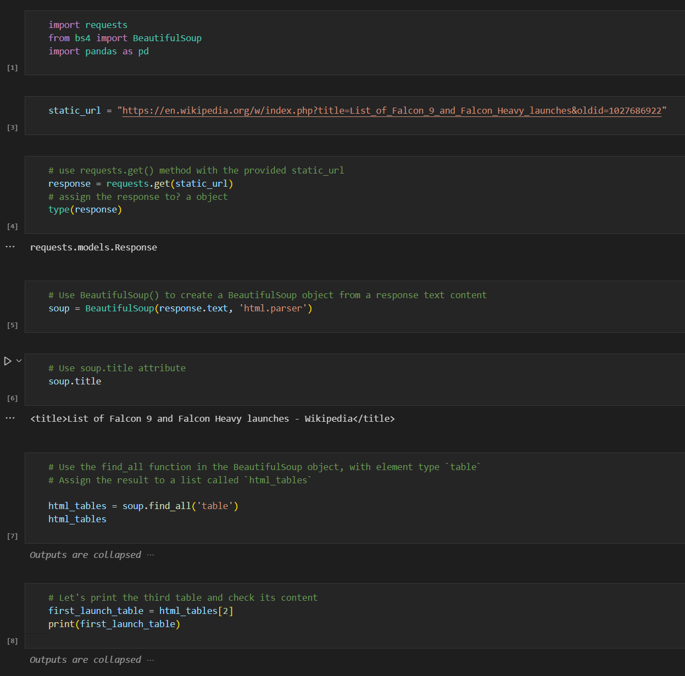
Data Collection - Scraping
BeauftifulSoup is a common python library that is used for webscraping.
In this project we utilized BeatutifulSoup to extract HTML tables from Wikipedia to extract additional SpaceX Launch data.
GitHub URL

Slide 10
Data Wrangling
Data Wrangling Included:
Better understanding the data with functions like:
.dtypes()
.describe()
.shape()
.is_null()
.value_counts()
We also added a column called “class” which simplified the landing_outcome column to a “good” or “bad” launch outcome
GitHub URL

Slide 11
EDA with Data Visualization
Charts Included
flight number and launch Site
payload and launch site
success rate of each orbit type
flight number and orbit type
the launch success yearly trend.
GitHub URL

Slide 12
EDA with SQL
In an effort to understand the SpaceX Launch data further, we loaded the dataset into an IBM Db2 database so we could apply EDA with SQL queries
SQL Queries Included:
The names of the unique launch sites
The total payload mass carried by boosters launched at various sites
The average payload mass carried by various booster types
The total number of successful and failed launches
The failed landing outcomes on drone ships, their booster versions, and the site names
GitHub URL

Slide 13
Build an Interactive Map with Folium
Using Folium an interactive map displaying the SpaceX Launch site locations, colored green if the mission was successful, and red if it was not.
Maps included map objects such as:
Markers – markers are used to display information about a location
Circles – these are identifiers for a location and can be highly customized
Lines – these are a powerful tool to show distances from certain locations or objects like rail roads
Adding these map objects gives the user more information to better understand the various launch sites.
GitHub URL

Slide 14
Build a Dashboard with Plotly Dash
Using Plotly Dash an interactive dashboard was created to analyze mission success/failure
Charts included
Pie Chart
Scatter Chart
Key features analyzed
Launch Site
Payload Mass
GitHub URL

Slide 15
Predictive Analysis (Classification)
SciKit-Learn was used to perform predictive analysis on launch outcomes using various classification methods.
First the model is split into X and Y, and then the data is further split into training and testing data
Once the data was ready various machine learning models were built
Results were improved by testing various hyperparameters using GridsearchCV
Once the optimal hyperparameters were in place we were able to determine which model had the highest accuracy
GitHub URL

Slide 16
Results
Exploratory data analysis results
Interactive analytics demo in screenshots
Predictive analysis results

Slide 17

Section 2

Slide 18
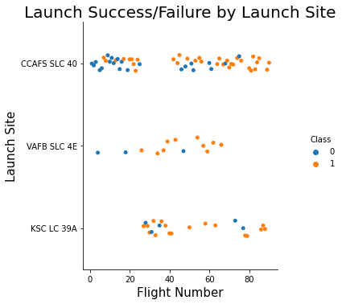
Flight Number vs. Launch Site
From the plot, we notice that the success rate (1) increases as the flight number increases
We also note CCAFS SLC 40 appears to have significantly more launches than the other sites

Slide 19
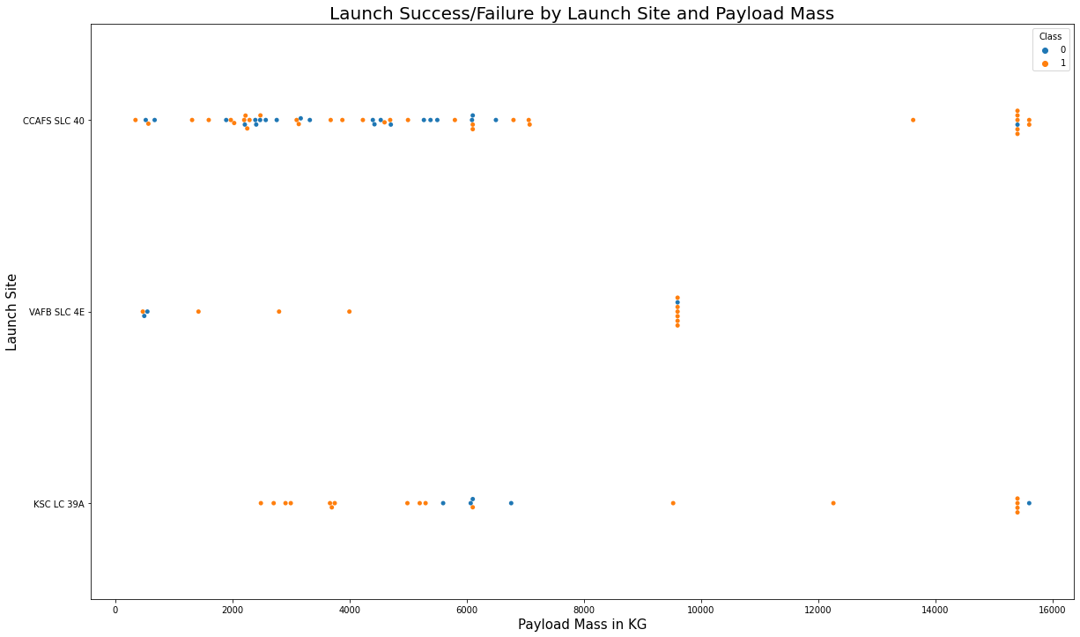
Payload vs. Launch Site
Payloads larger than 8,000 KG tend to be more successful
Many of the failed launches result in the occur between payload mass of 4,000kg and 6,000kg at CCAFS SLC 40.

Slide 20
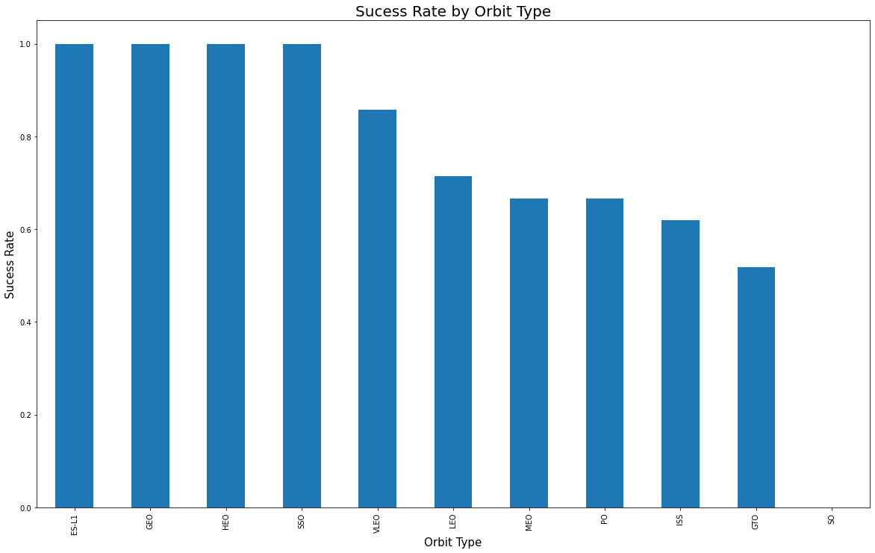
Success Rate vs. Orbit Type
Half of the orbit types have 80-100% success rate
ES-L1, GEO, HEO, SSO, VLEO
SO, GTO and ISS are the least successful launch types

Slide 21
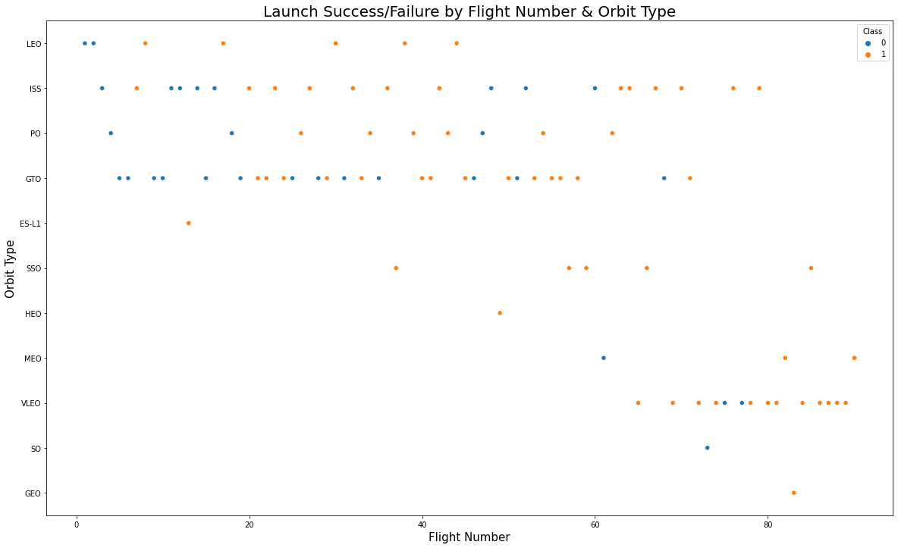
Flight Number vs. Orbit Type
Following up on the last slide, SO had a 0% success rate; however, there has only been 1 attempt so more information is likely needed
GTO and ISS had some of the lower success rates, but here we notice many of them occurred towards the beginning indicating improvement over time

Slide 22
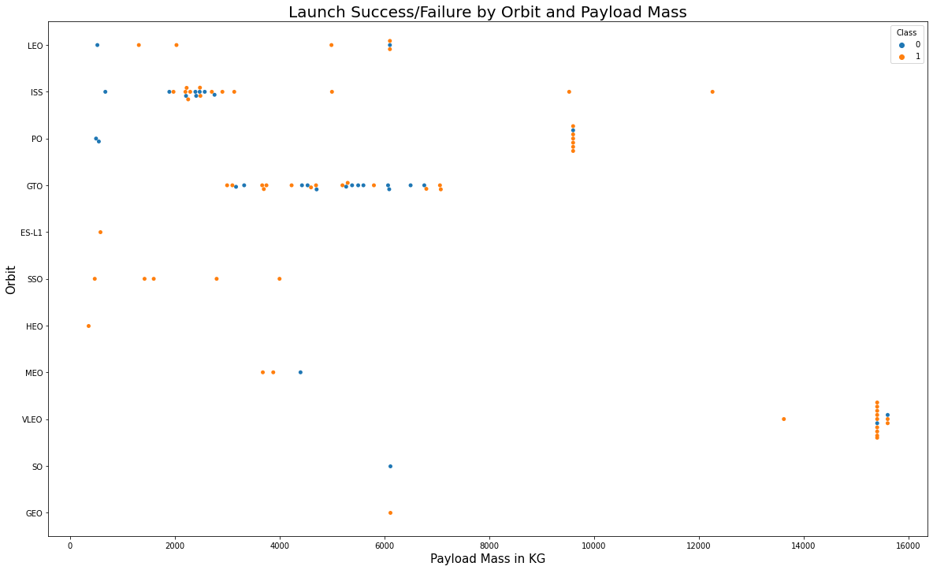
Payload vs. Orbit Type
Here we continue to notice that the launches carrying heavier payload mass are more successful
Despite the lower payload mass ES-L1, SSO, and HEO have all been successful with lower a lower payload mass

Slide 23
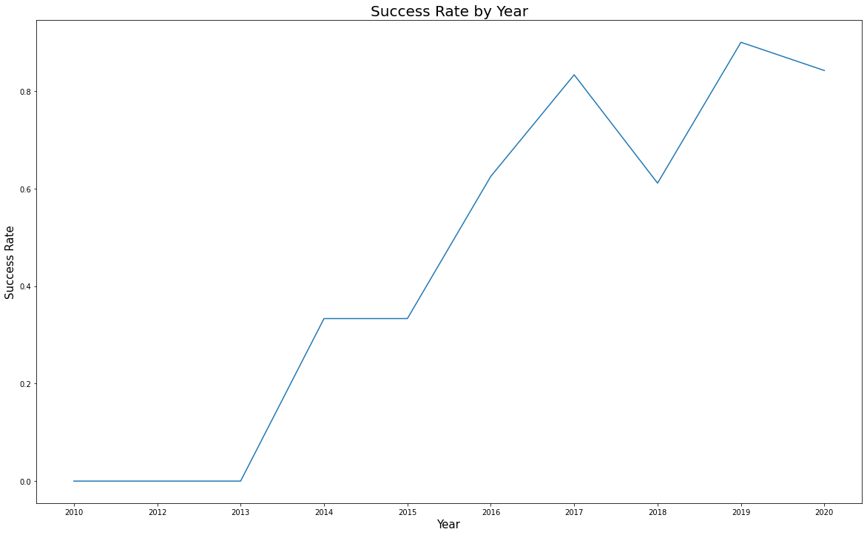
Launch Success Yearly Trend
From 2010 to 2012 there were no successful launches
In 2013, successful launches began to trend up significantly
From 2016 to 2020 success rates hovered around 80%, with 2018 being the exception at 60%

Slide 24
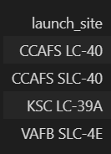
All Launch Site Names
SQL was also utilized for exploratory data analysis
For the SQL queries we use “SPACEX” as the source table
Here you can see the various launch sites

Slide 25
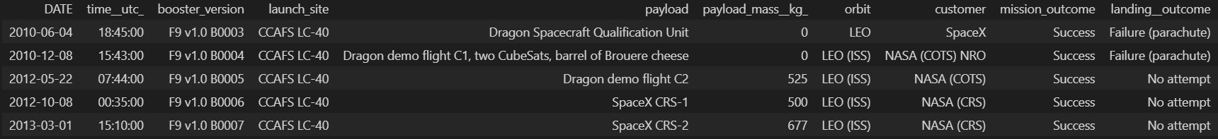
Launch Site Names Begin with 'CCA'
Below, we utilized SQL to see Launches at Launch Site location beginning with “CCA”
This then allowed us to do further analysis on a specific site

Slide 26
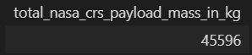
Total Payload Mass
SQL can also be used to total values
In this example we were able to find out the total payload mass sent by NASA on SpaceX Launches

Slide 27
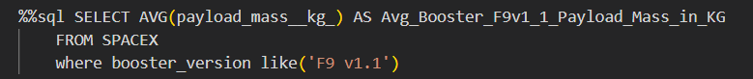
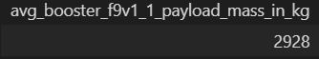
Average Payload Mass by F9 v1.1
In this example we totaled the payload mass for a specific booster type, the F9 V1.1.

Slide 28
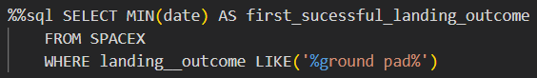
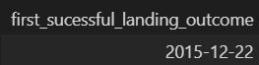
First Successful Ground Landing Date
Dates are also easy to work with in SQL
Here we were able to determine the first ground landing date was December 22nd, 2015.

Slide 29
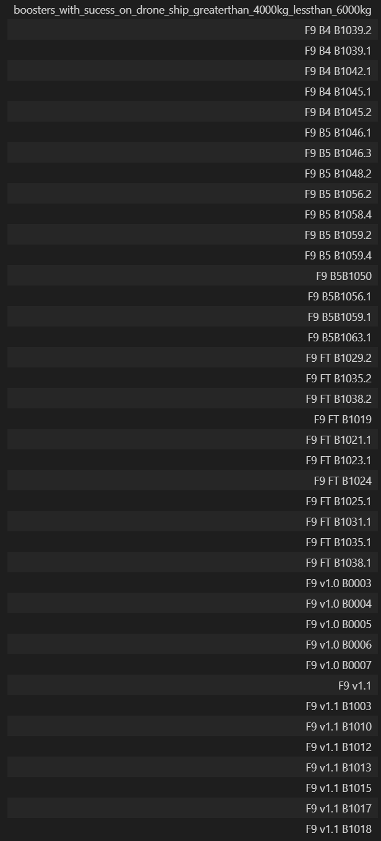
Successful Drone Ship Landing with Payload between 4000 and 6000
SQL has a variety of methods to filter tables to extract the exact data needed.
In this example we were able to find the boosters that had a payload mass greater than 4,000 KG but less than 6,000 KG

Slide 30
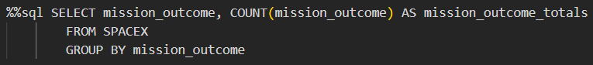
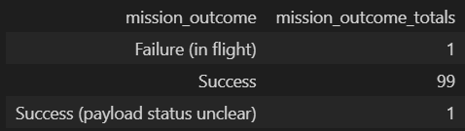
Total Number of Successful and Failure Mission Outcomes
SQL also allows users to group values for further analysis
In this example we grouped all of the mission outcomes and can see only one mission failed in flight.

Slide 31
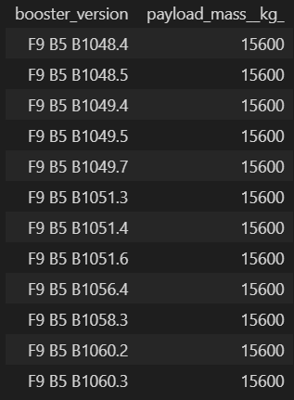
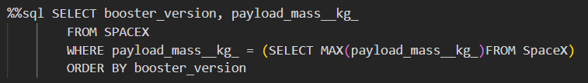
Boosters Carried Maximum Payload
In this example, we were able to determine the maximum payload mass that has been carried by a booster, and then use that to determine which boosters carried the maximum payload mass.

Slide 32
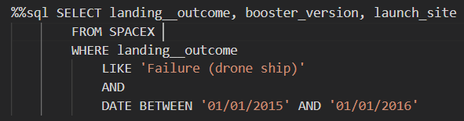
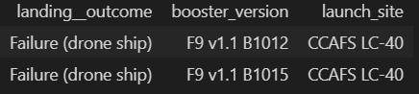
2015 Launch Records
In this example we were able to find the failed drone ship missions for a specific year

Slide 33
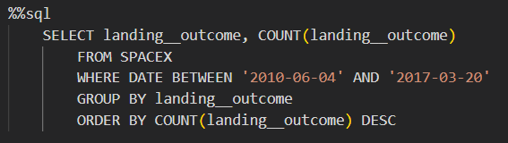
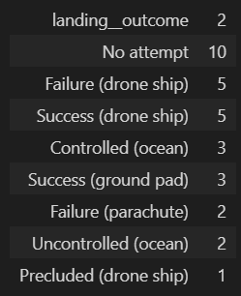

Rank Landing Outcomes Between 2010-06-04 and 2017-03-20
Lastly, we grouped and sorted the launches by the various Landing Outcomes

Slide 34

Section 3

Slide 35
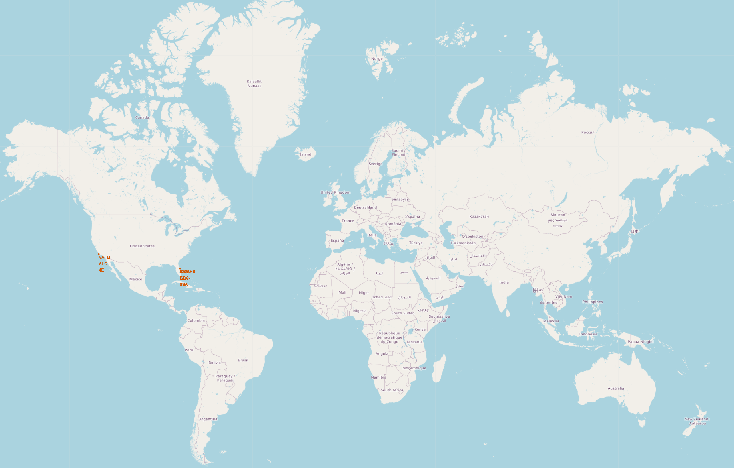
SpaceX Launch Sites on the World Map
So far SpaceX Launch sites are all in the US on coastlines

Slide 36
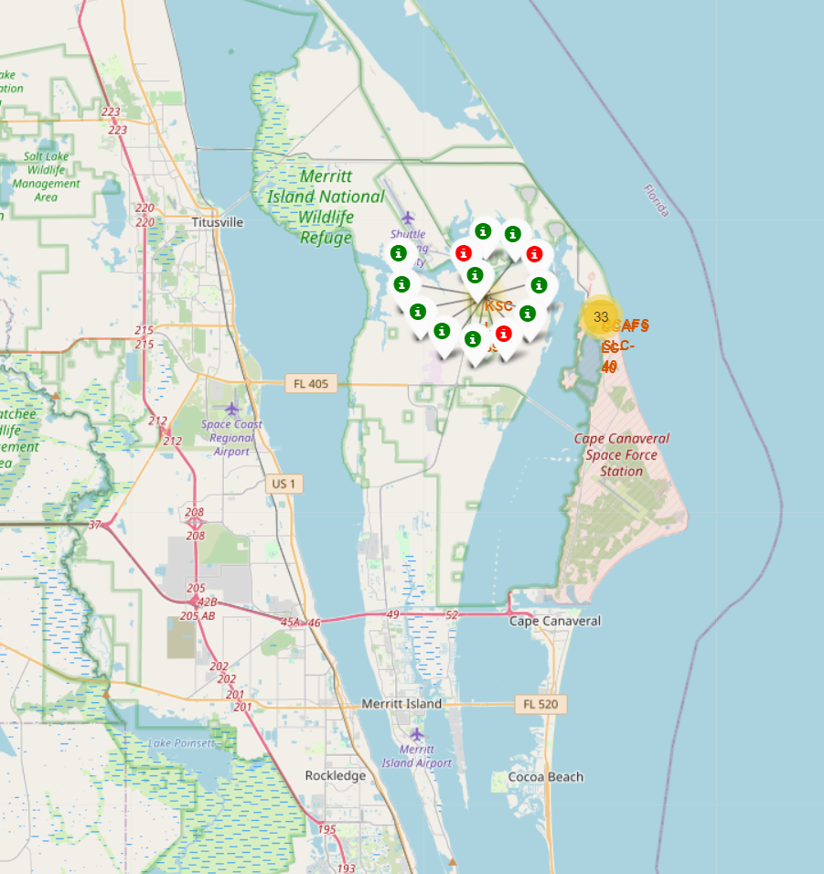
Map of SpaceX Launch Outcomes
The Folium library allows us to add markers for each SpaceX launch.
Here we were able to color code them green for success and red for failed mission.
When zoomed out, the total number of launches is displayed as seen in yellow here.

Slide 37
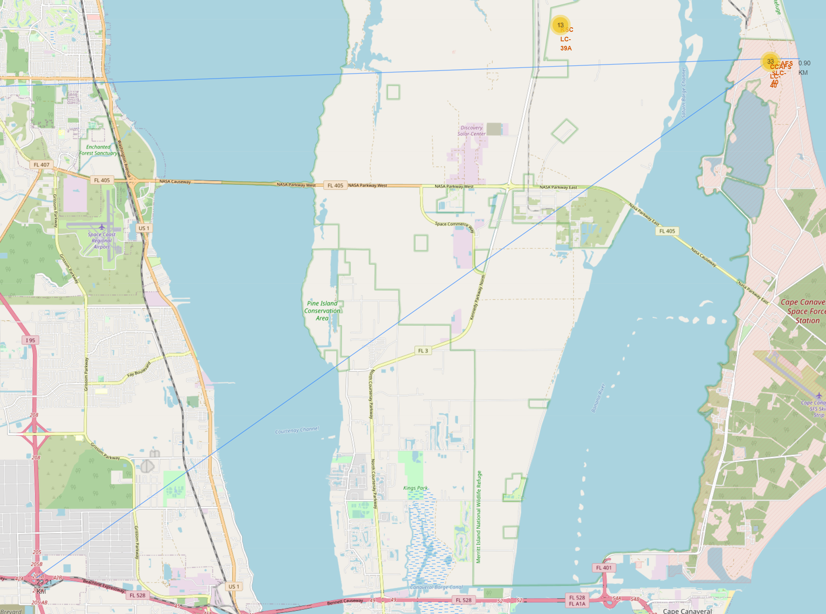
Distances from Key Locations
The Folium library also allows us to calculate and display distances between various locations.
In this example we have blue lines to the closest ocean, highway, and the closest city.

Slide 38

Section 4

Slide 39
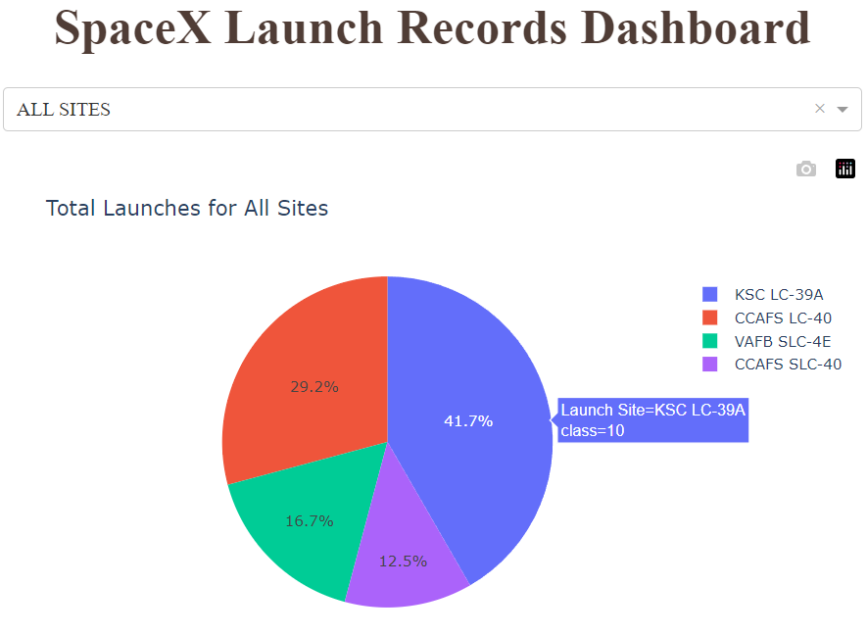
Piechart of Total Successful Records by Site
With Pandas, Dash, and Plotly a dashboard was created to display launch outcomes
In this pie chart we have totaled the successful launches and sorted them by launch site
Here we can see KSC LC-39A has the most successful missions

Slide 40
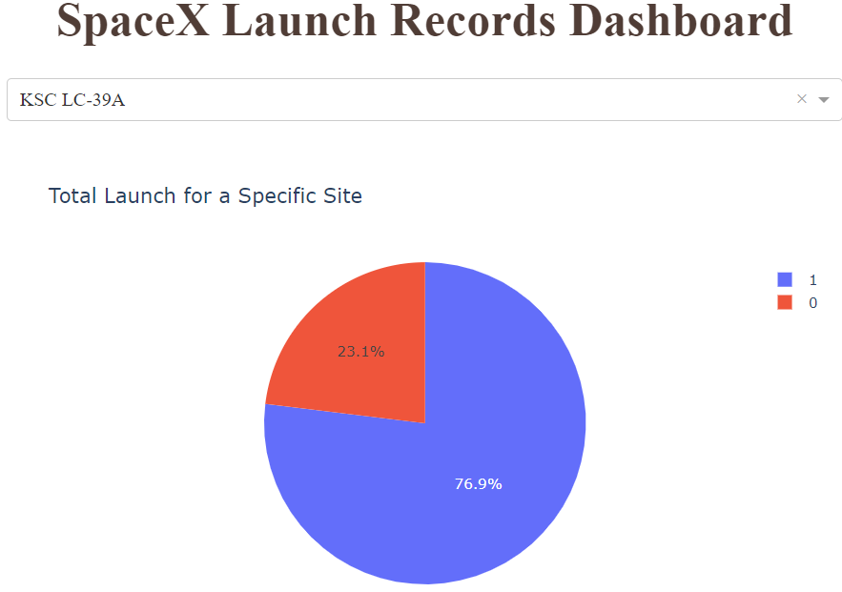
Total Lanches for a Specific Site
When we use the dropdown filter and change the selection to a specific launch site we are able to see the breakdown of successful and failed launches

Slide 41
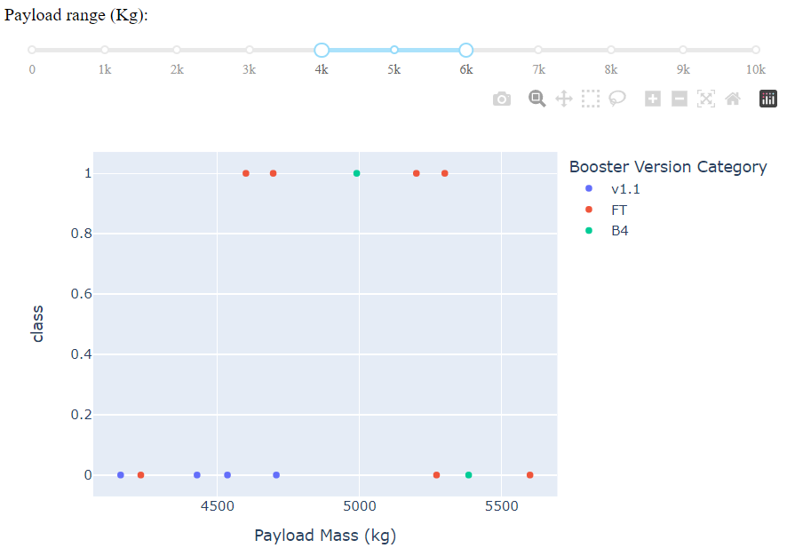
Payload Mass by Booster Type
In the same dashboard we were also able to plot the various booster types by their payload mass.
We are even able to add a sliding selection bar to further analyze certain payload ranges that might be of interest.

Slide 42

Section 5

Slide 43
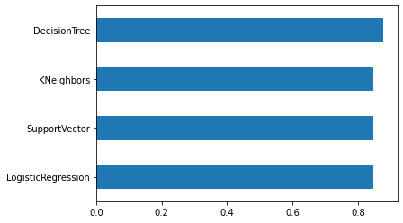
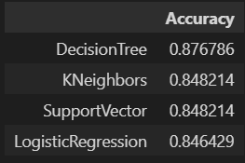
Classification Accuracy
Using Sci-Kit Learn we are able to create machine learning models to try and predict the outcome of launches before they occur.
Most models had similar accuracy for this project, but the Decision Tree model performed the best.

Slide 44
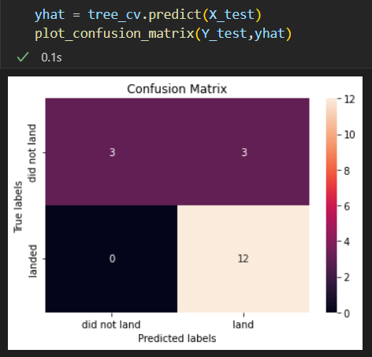
Confusion Matrix
We can further analyze the Decision Tree model with a confusion matrix.
While the model predicted 15 of the 18 correctly, it still was not able to identify 3 of the 6 missions that did not land

Slide 45
Conclusions
Launches with larger payload mass have a higher rate of success.
Orbit types can also be a useful indicator of how successful a mission will be.
Orbit types ES-L1, GEO, HEO, SSO, VLEO were all 80-100% successful
KSC LC-39A have the most successful launches of any sites; 76.9%.
Classification algorithms were accurate predictors of launch outcomes.
Accuracy ranged from 84-87% with the Decision Tree Algorithm performing the best.
Since 2013 the trend of successful missions has increased drastically.
Missions from 2016 to 2020 had an average success rate of 76% and 2019 to 2020 was 87%.
This is an impressive improvement that will forever change the approach to future space missions.

Slide 46


